Slide 1

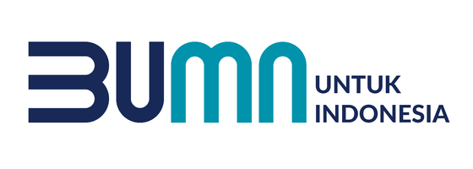
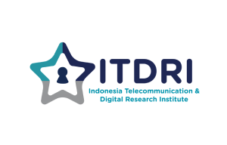

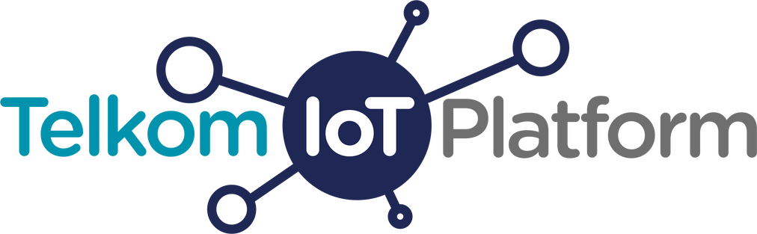
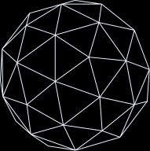

Product
Document
Telkom IoT Platform

Slide 2
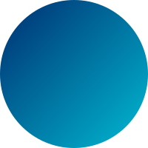
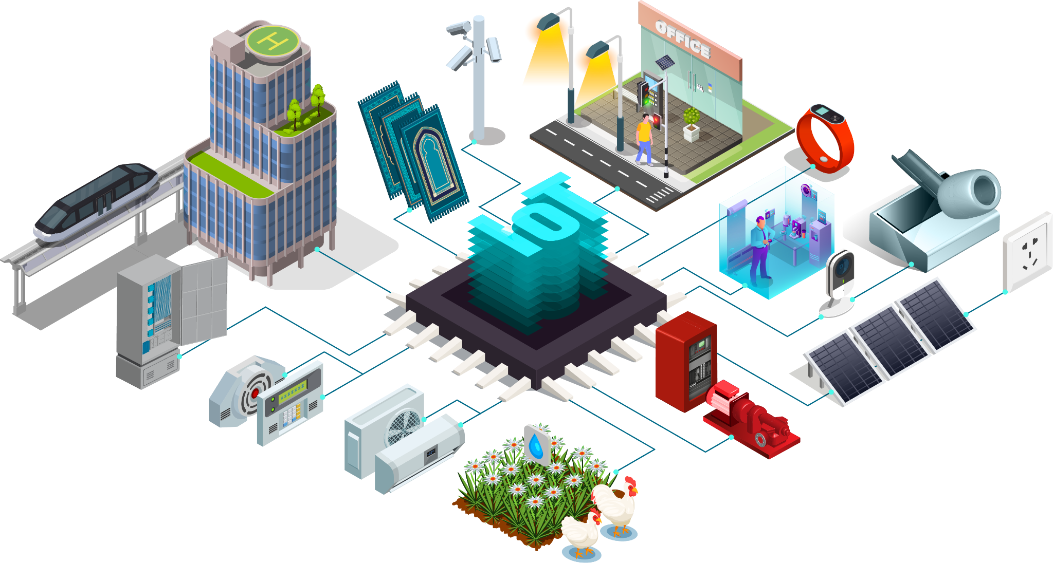
How Internet of Things (IoT) Works ?
The Internet of Things collects data from the environment via sensors or other IoT devices and sends data to the IoT gateway through various connectivity. From the IoT gateway, the data is sent to the cloud to be processed and analyzed. IoT devices also act as controllers to manipulate the environment without human intervention.

Slide 3
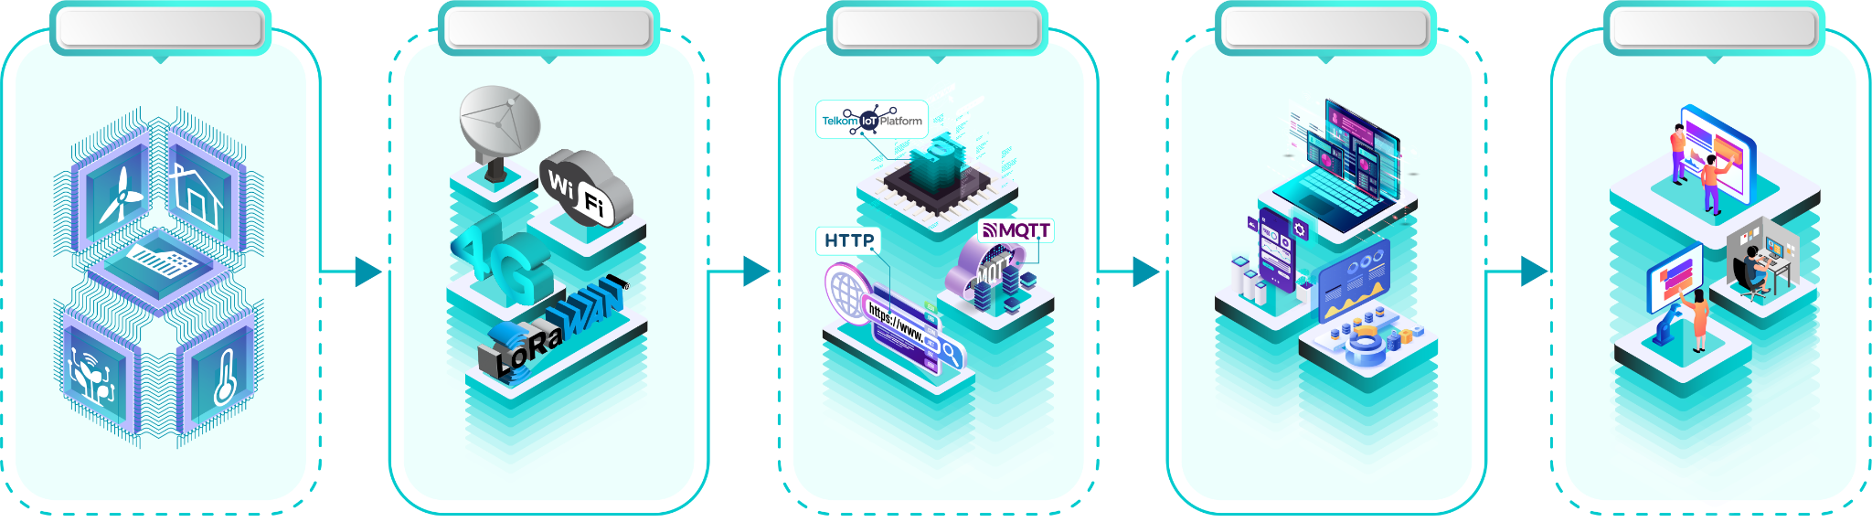
What is IoT Platform ?
IoT platform is an essential component in the IoT value chain. IoT Platform has a crucial role to collect the data sent from IoT devices to be processed by IoT application through secure and reliable protocols like MQTT. Formed by microservices, the IoT platform enables to create IoT applications for monitoring and control. IoT platform offers unique features like device management, interoperability from various device brands, agnostic to any connectivity, and personal dashboard.
IoT Device
Network
Platform
Application
Customer

Slide 4
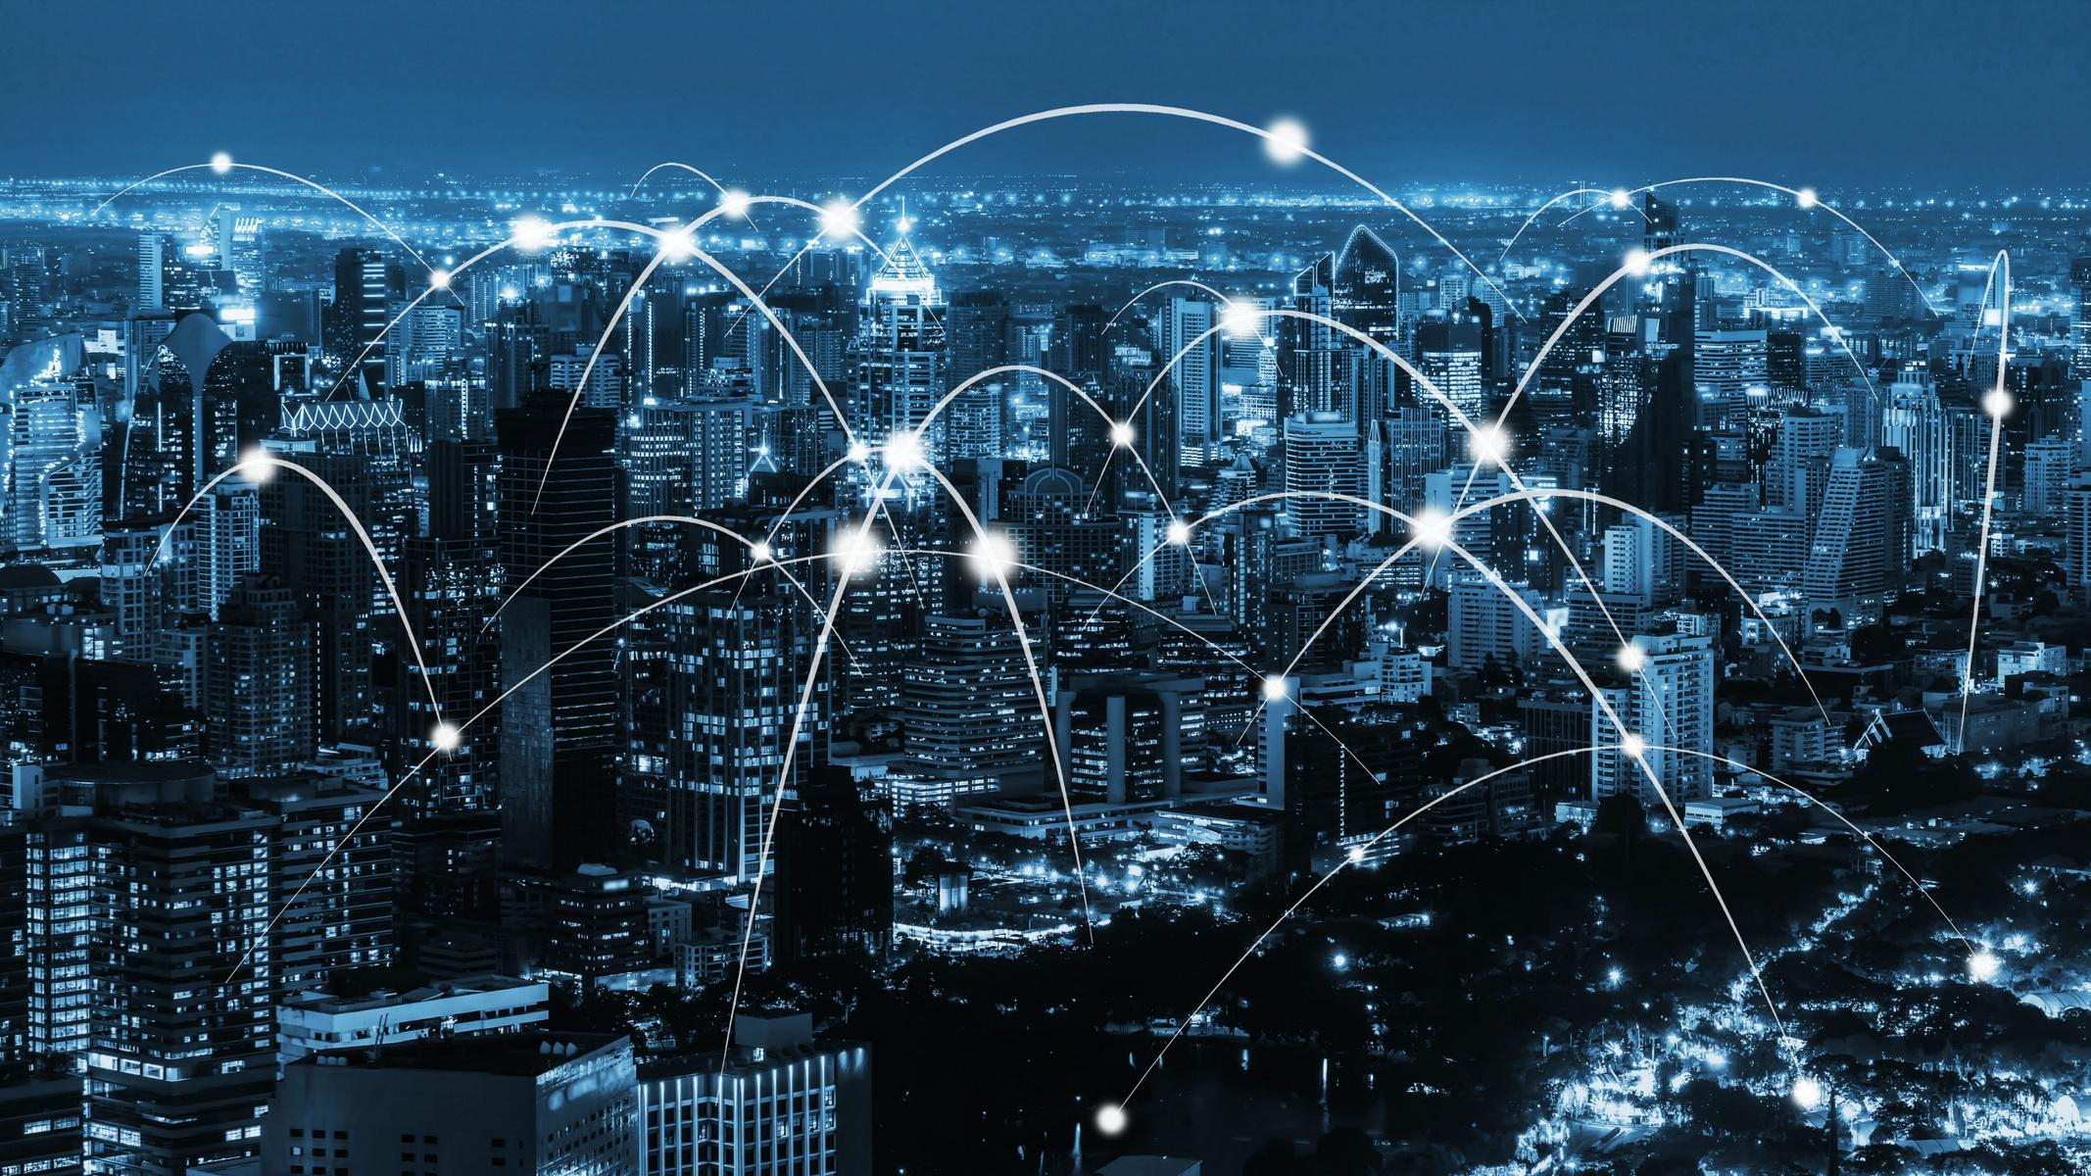
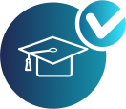

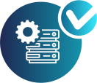

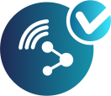

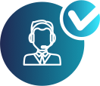

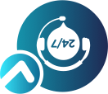

Why You Should Use
Telkom IoT Platform ?
We provide B2B collaboration for academic research free of charge (T&C applies)
Maintenance free for the server and storage
Integrated with Telkom LoRAWAN Network
Expert Consulting Service
24x7 Helpdesk Team

Slide 5


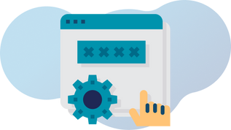
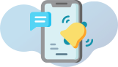

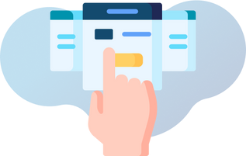
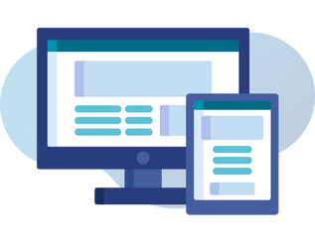
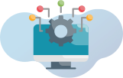
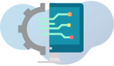
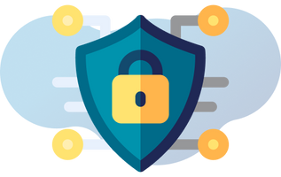
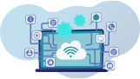
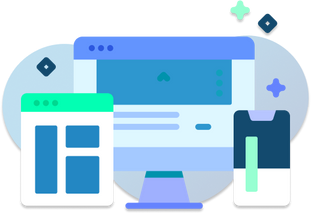
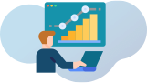
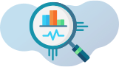
Features
1
2
3
4
Device Management
Agnostic Connectivity Integration
Easy Set Up With The Wizard
Personal Dashboard
5
6
7
8
Event Trigger
Notification
Security Token Management
High Availability & Reliable Platform with 24x7 Support
9
10
11
12
Use Case Monitoring
and Report
Big Data Analytics
Device Interoperability
Microservices-Based

Slide 6

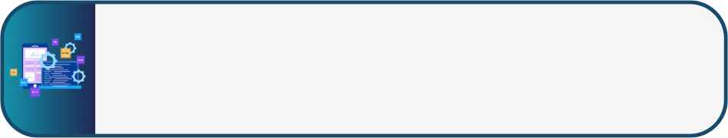

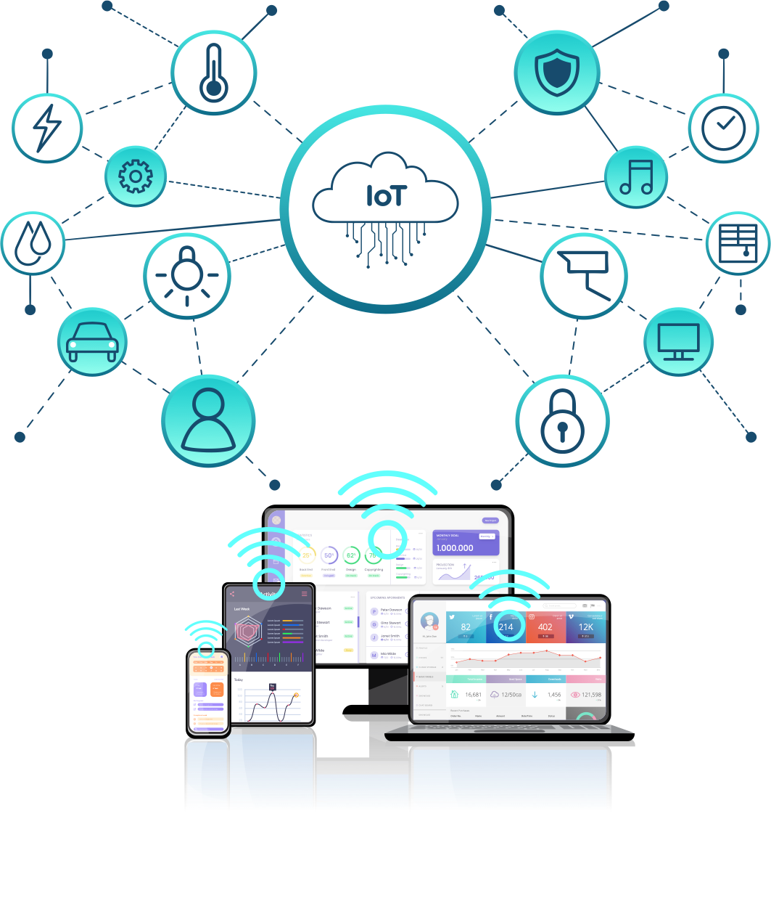

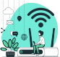

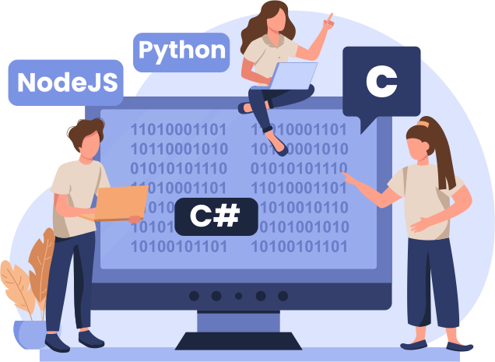

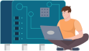
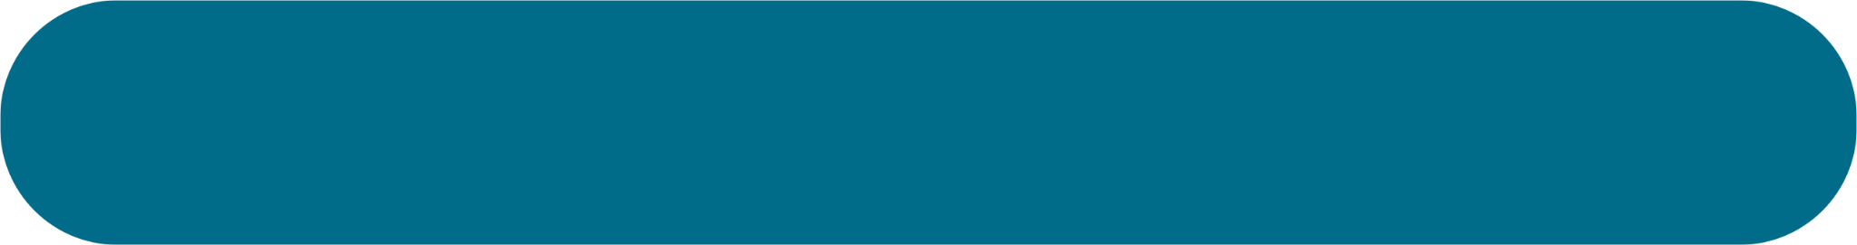
Technology Stack
5
Cloud Applications
App Developer
The customer interface for dashboards, settings
and devices
For application development outside the platform, we provide real time data via HTTP and MQTT protocols. We also provide API to retrieve data up to 3 months.
Personal Dashboard
You can create your personal dashboard by displaying sensor data in various types of widgets such as charts, maps, tables etc.
Things
Physical objects found in your home, workplace and everyday life
Event Trigger
You can add logic to call the API, send email/SMS/WhatsApp/etc.
4
Cloud Platform
Where data from IoT devices is captured, processed and stored
3
Communications
Connectivity Provider
How devices connect to the internet and transfer data
LoRa, WiFi, 4G, VSA.
2
Device Software
Device Library
Runs on the device’s processor and controls its functionality
We provide library for device written with C, C#. NodeJS and python language
1
Device Hardware
Device Fabricator
Embedded into ‘Things’
in the IoT
Provides decoders for devices on the market, so that sensor data can be used directly.
Step by step using Telkom IoT Platform
Registration
Create an Application
Create
Device
Data
Integration
Create Personal Dashboard and Choose Data Widget
You’re Good to Go! Orchestrate your IoT Data now

Slide 7

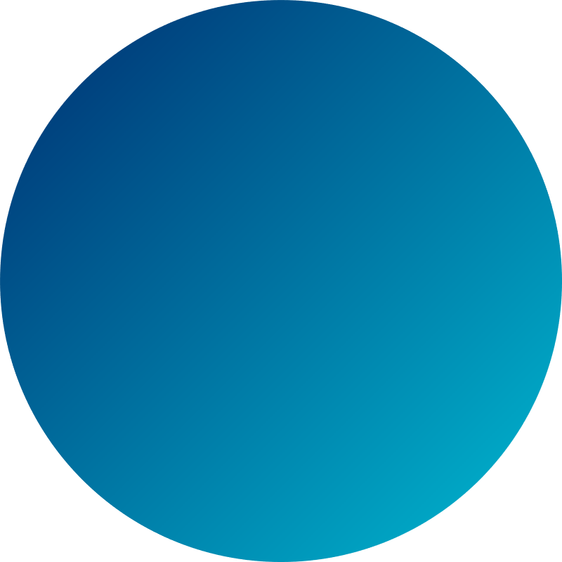
Our Portfolio
Industry Category
Use Cases
Optical Distribution Cabinet (ODC) Monitoring
Safety Systems Digitalization
Digital Inventory Management (DIM)
Assets & Inventory
Smart City
Smart Public Street Lighting
Health Care
Yakes Care Corner (YCC)
Utilities
Smart Metering
Poultry
Smart Poultry
Durian Smart Plantation
Agriculture
Soil Nutrients Monitoring
Tracking
Digital Prayer Mat

Slide 8
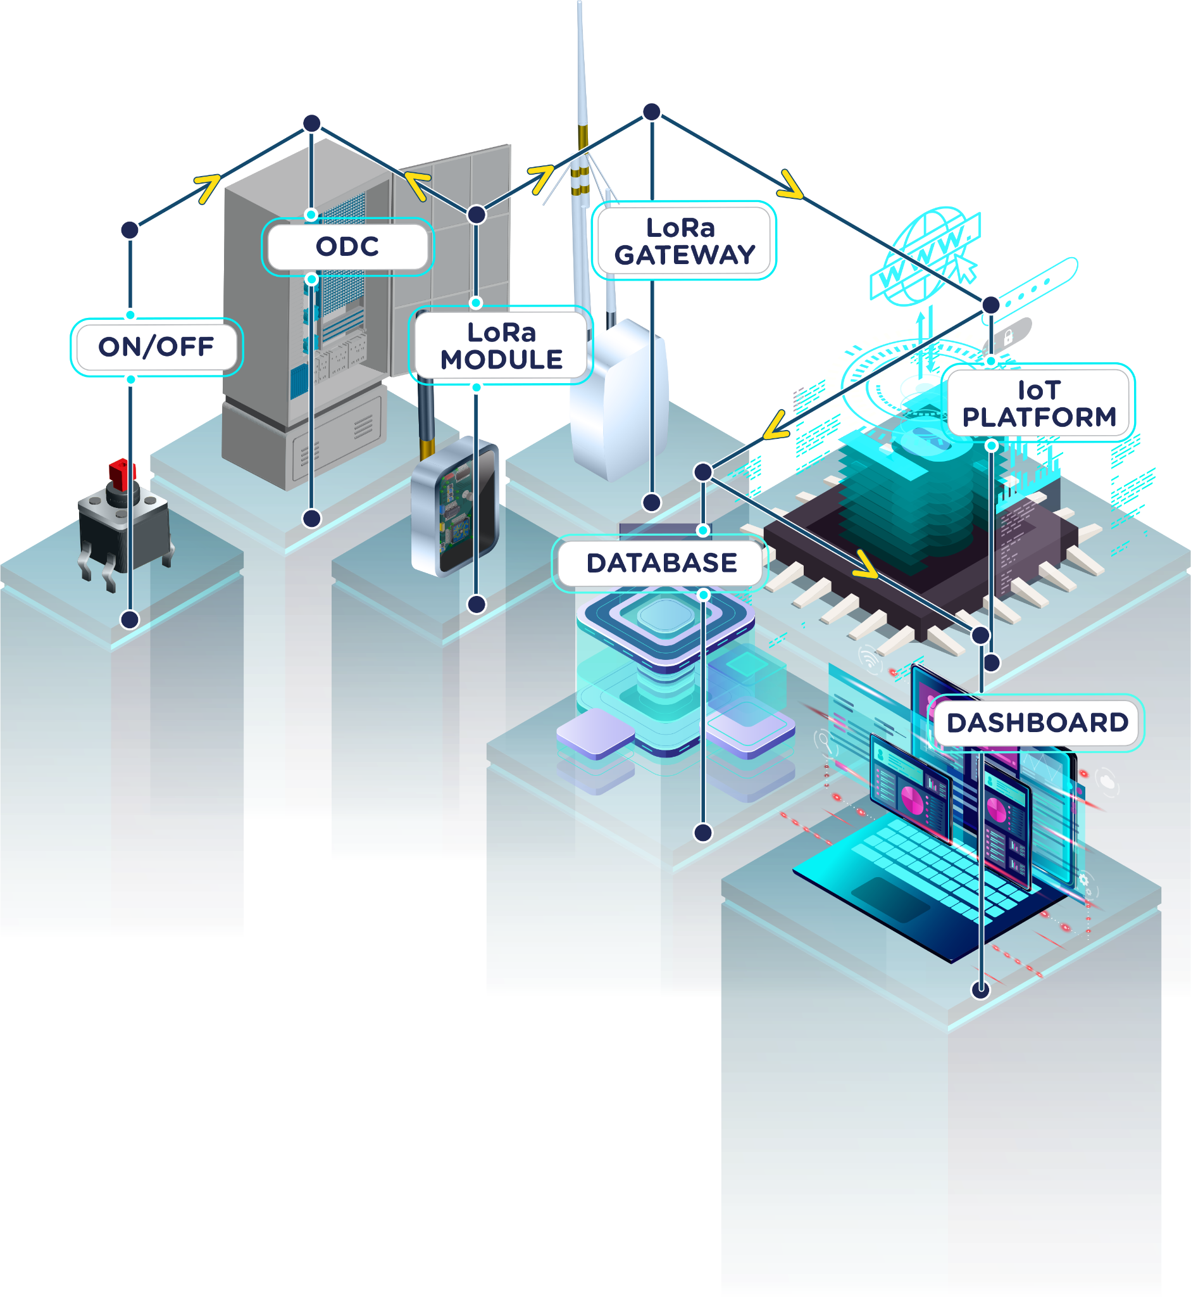
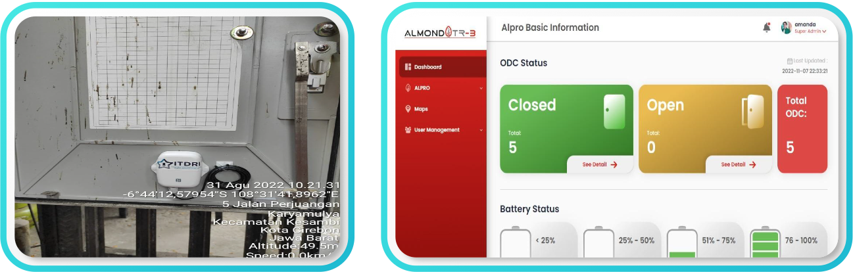
Optical Distribution Cabinet Monitoring
Optical Distribution Cabinet (ODC) monitoring is an Internet of Things (IoT)-based technology to monitor the door open/close status, temperature, and humidity of the ODC(s). This monitoring system will help to reduce interruption of IndiHome service and in the end will improve IndiHome’s customer experience (CX).

Slide 9
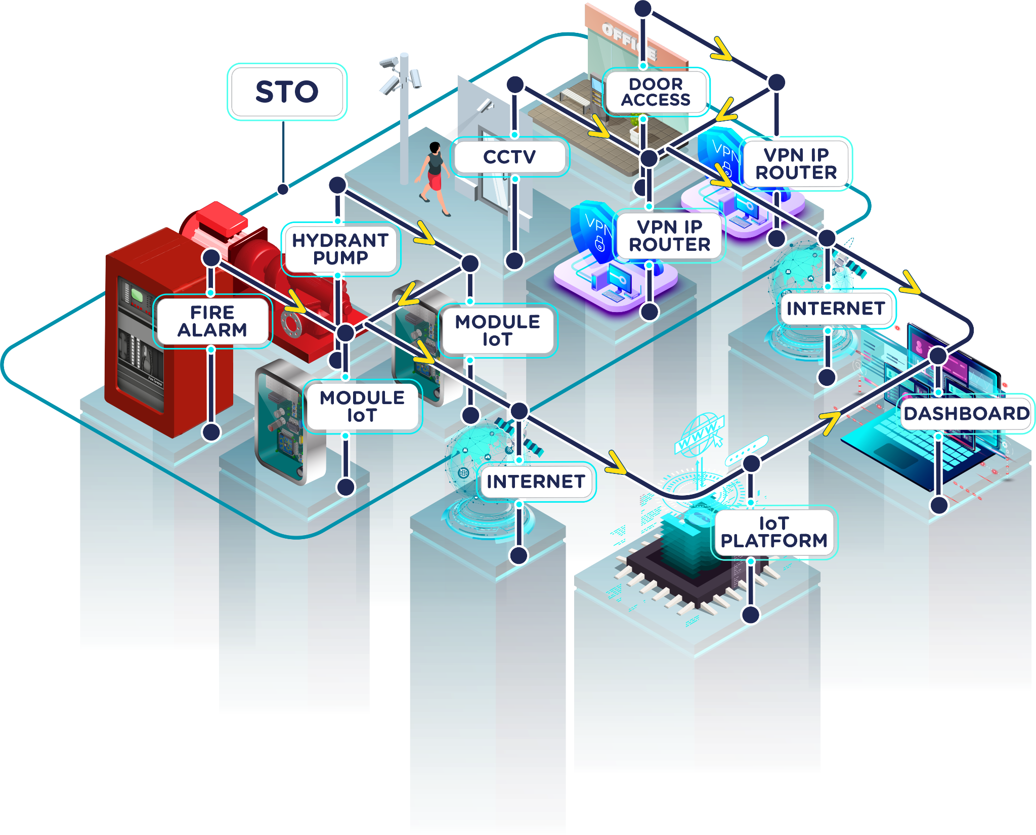
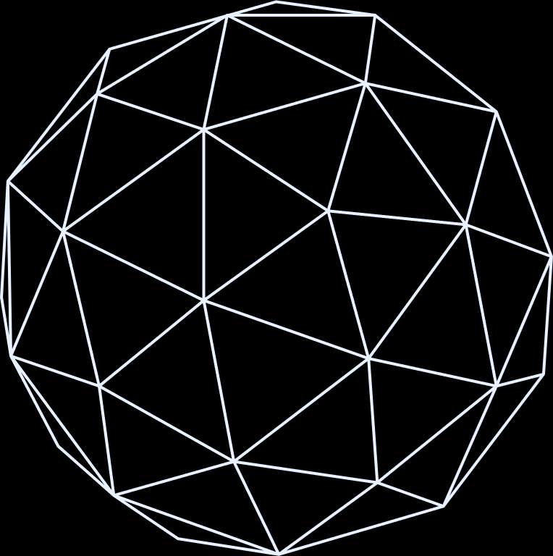
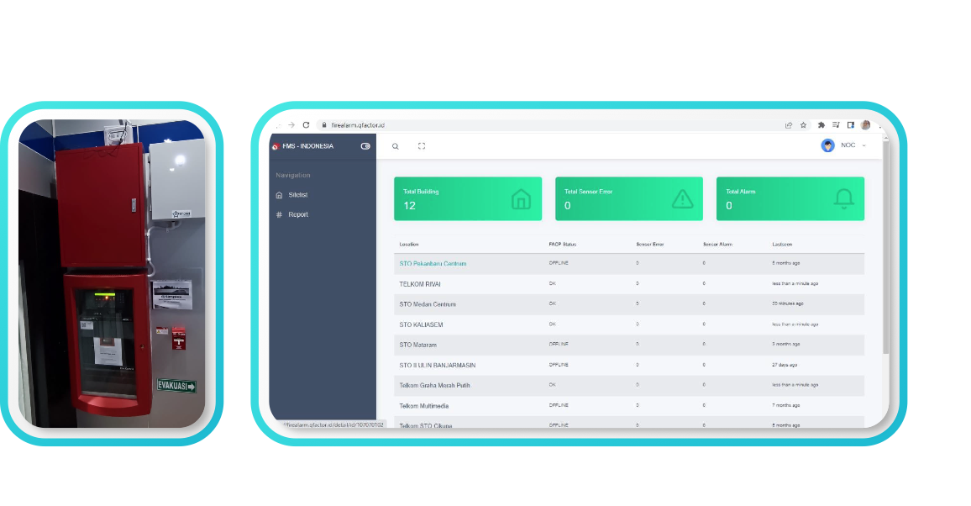
Safety Systems Digitalization
Safety Systems Digitalization is part of smart building systems which role is to monitor fire alarms, fire suppression, hydrant, CCTV, and door access. SSD is delivered to enhance the safety system of Telkom buildings nationwide.

Slide 10
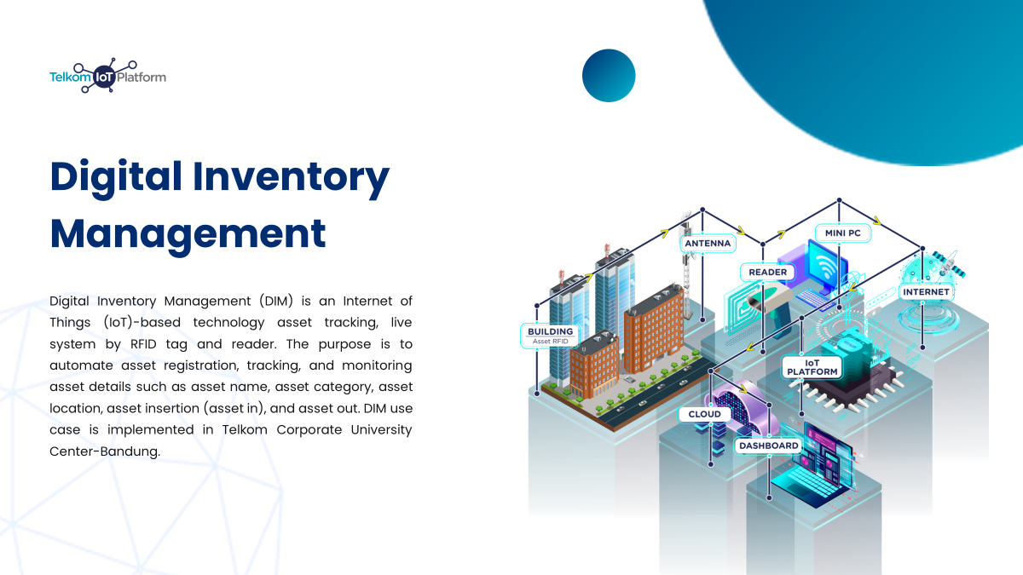

Slide 11
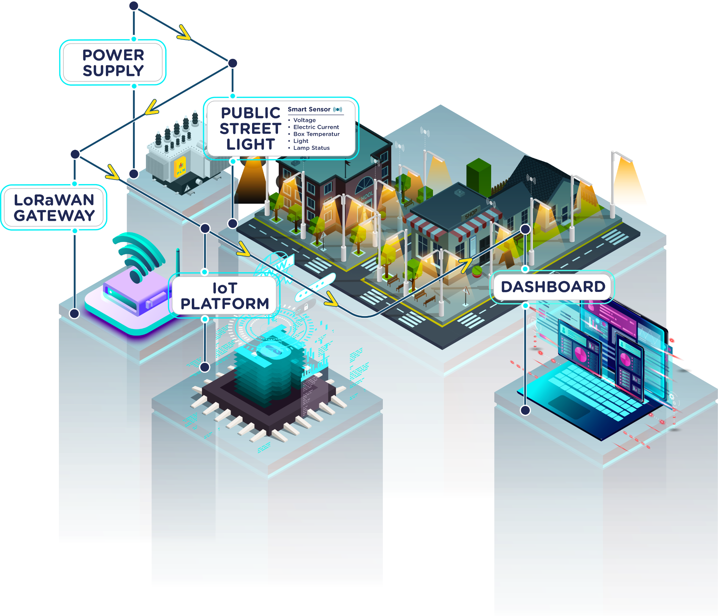
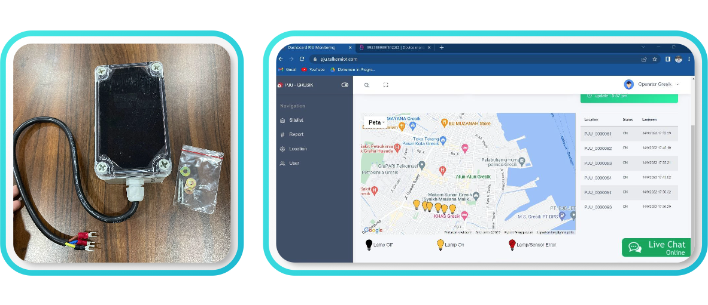
Smart Public Street Lighting
Smart Public Street Lighting aligns with smart city implementation, intended to monitor and control street lightings using low cost, low power, and wide area IoT connectivity. Besides, this solution can also calculate the usage of electricity power of individual street lighting as well.

Slide 12
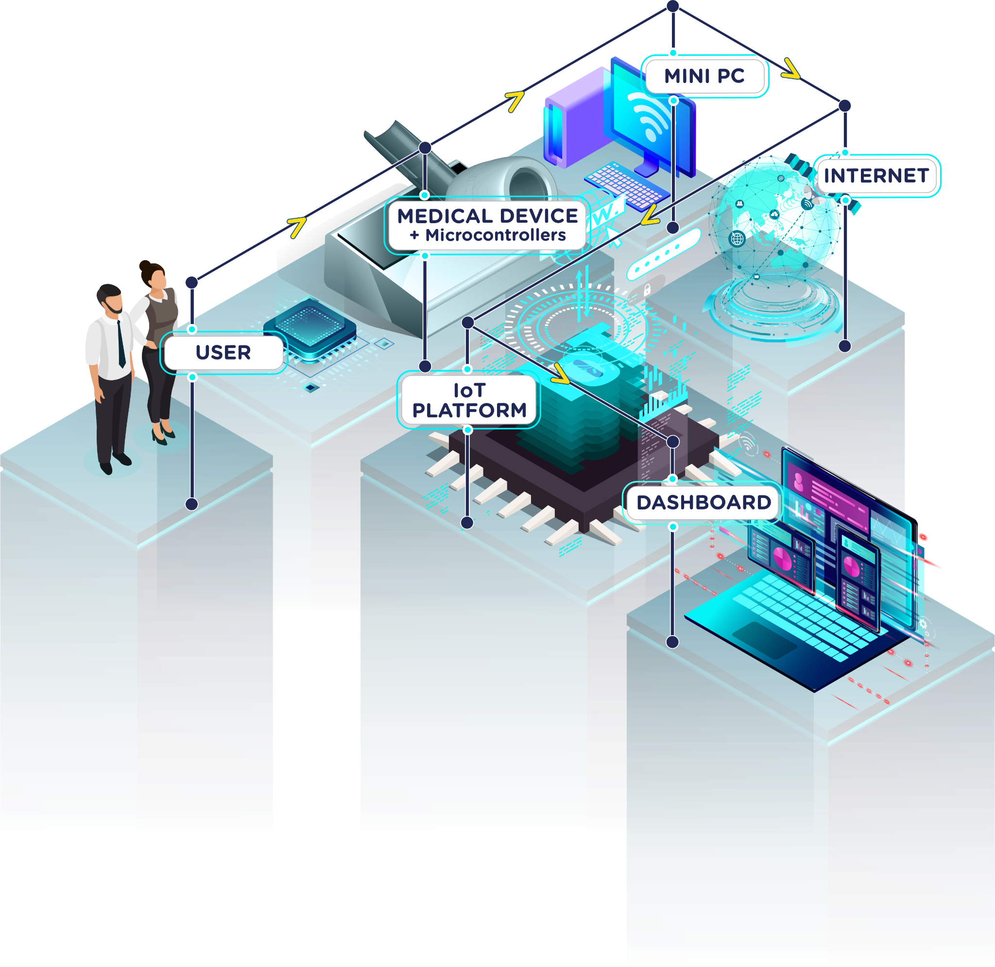
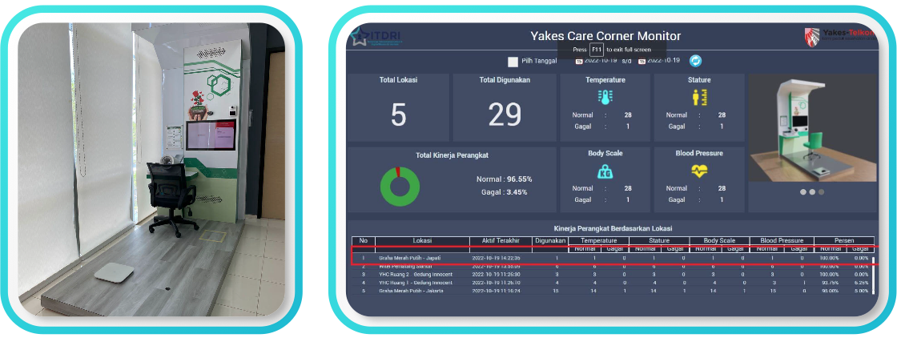
Yakes Care Corner
Yakes Care Corner (YCC) aims to extend the access to healthcare service with features like self-service vital body checks (body temperature, body weight, body height, and blood pressure) followed by teleconsultation with doctor. YCC booths will be placed in various Telkom offices with hope to improve the digital customer experience of Yakes participants and Telkom Group employees.

Slide 13
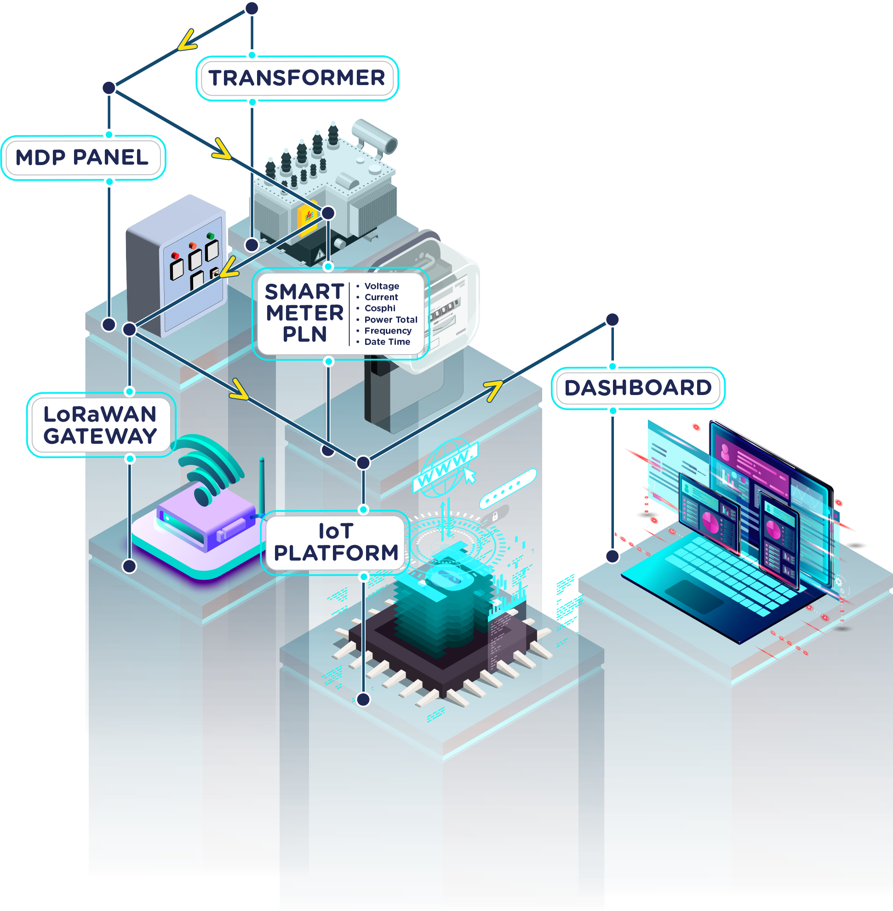
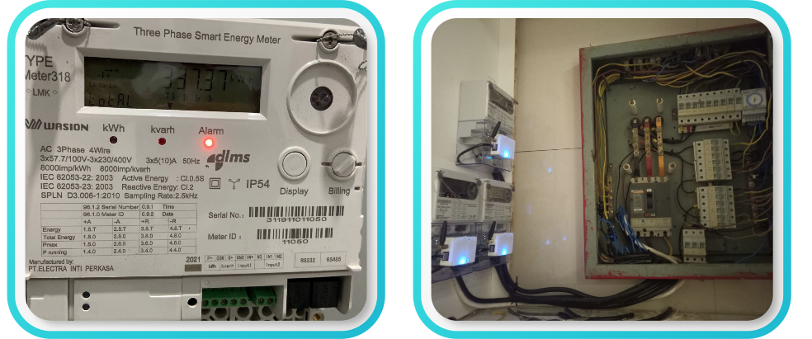
Smart Metering
The need for smart grid implementation is inevitable, therefore intelligent metering systems are under intense discussion to be implemented in these years. Electricity, water, and gas meters need an automated metering infrastructure so that users can track their profitability and maintain excellent service as well. Telkom IoT Platform along with LoRaWAN connectivity can support this use case with reliable and low-cost services.

Slide 14
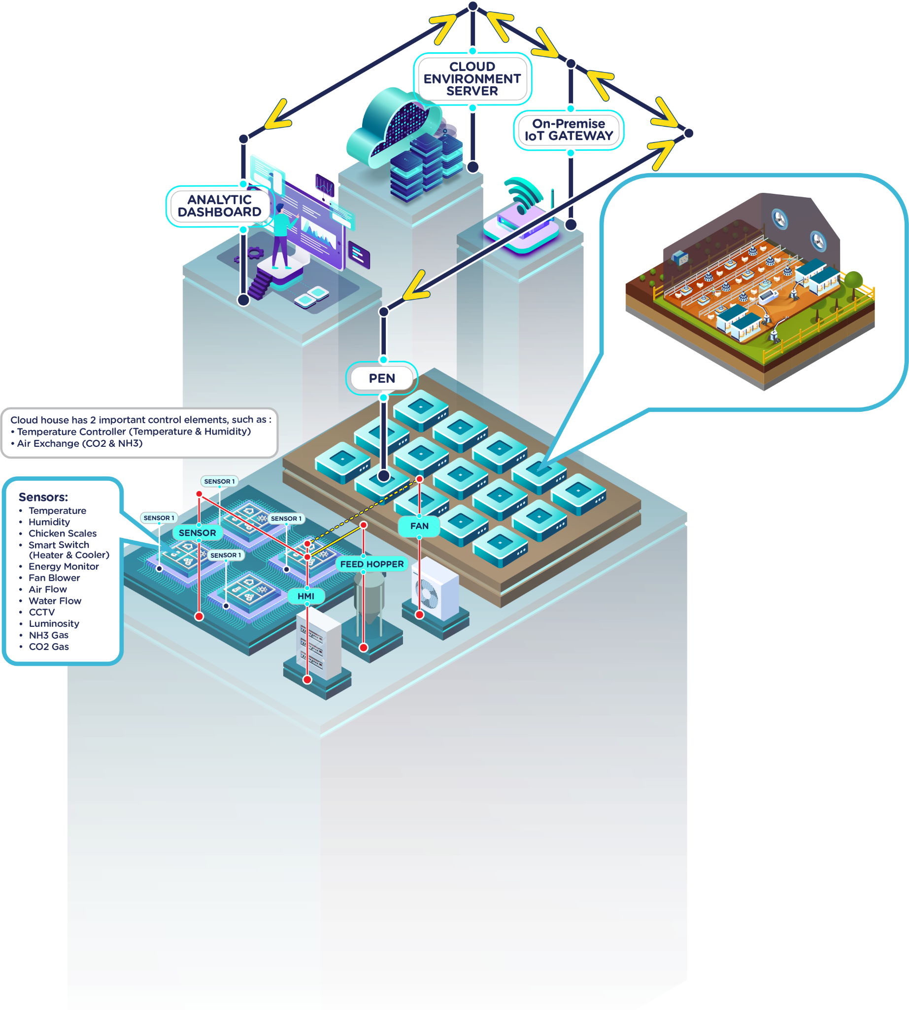
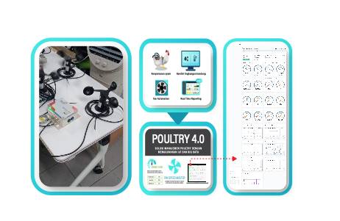
Smart Poultry
Utilization of IoT to maintain "food security" and "breeder independence" to increase the productivity of Indonesian chicken farms.

Slide 15
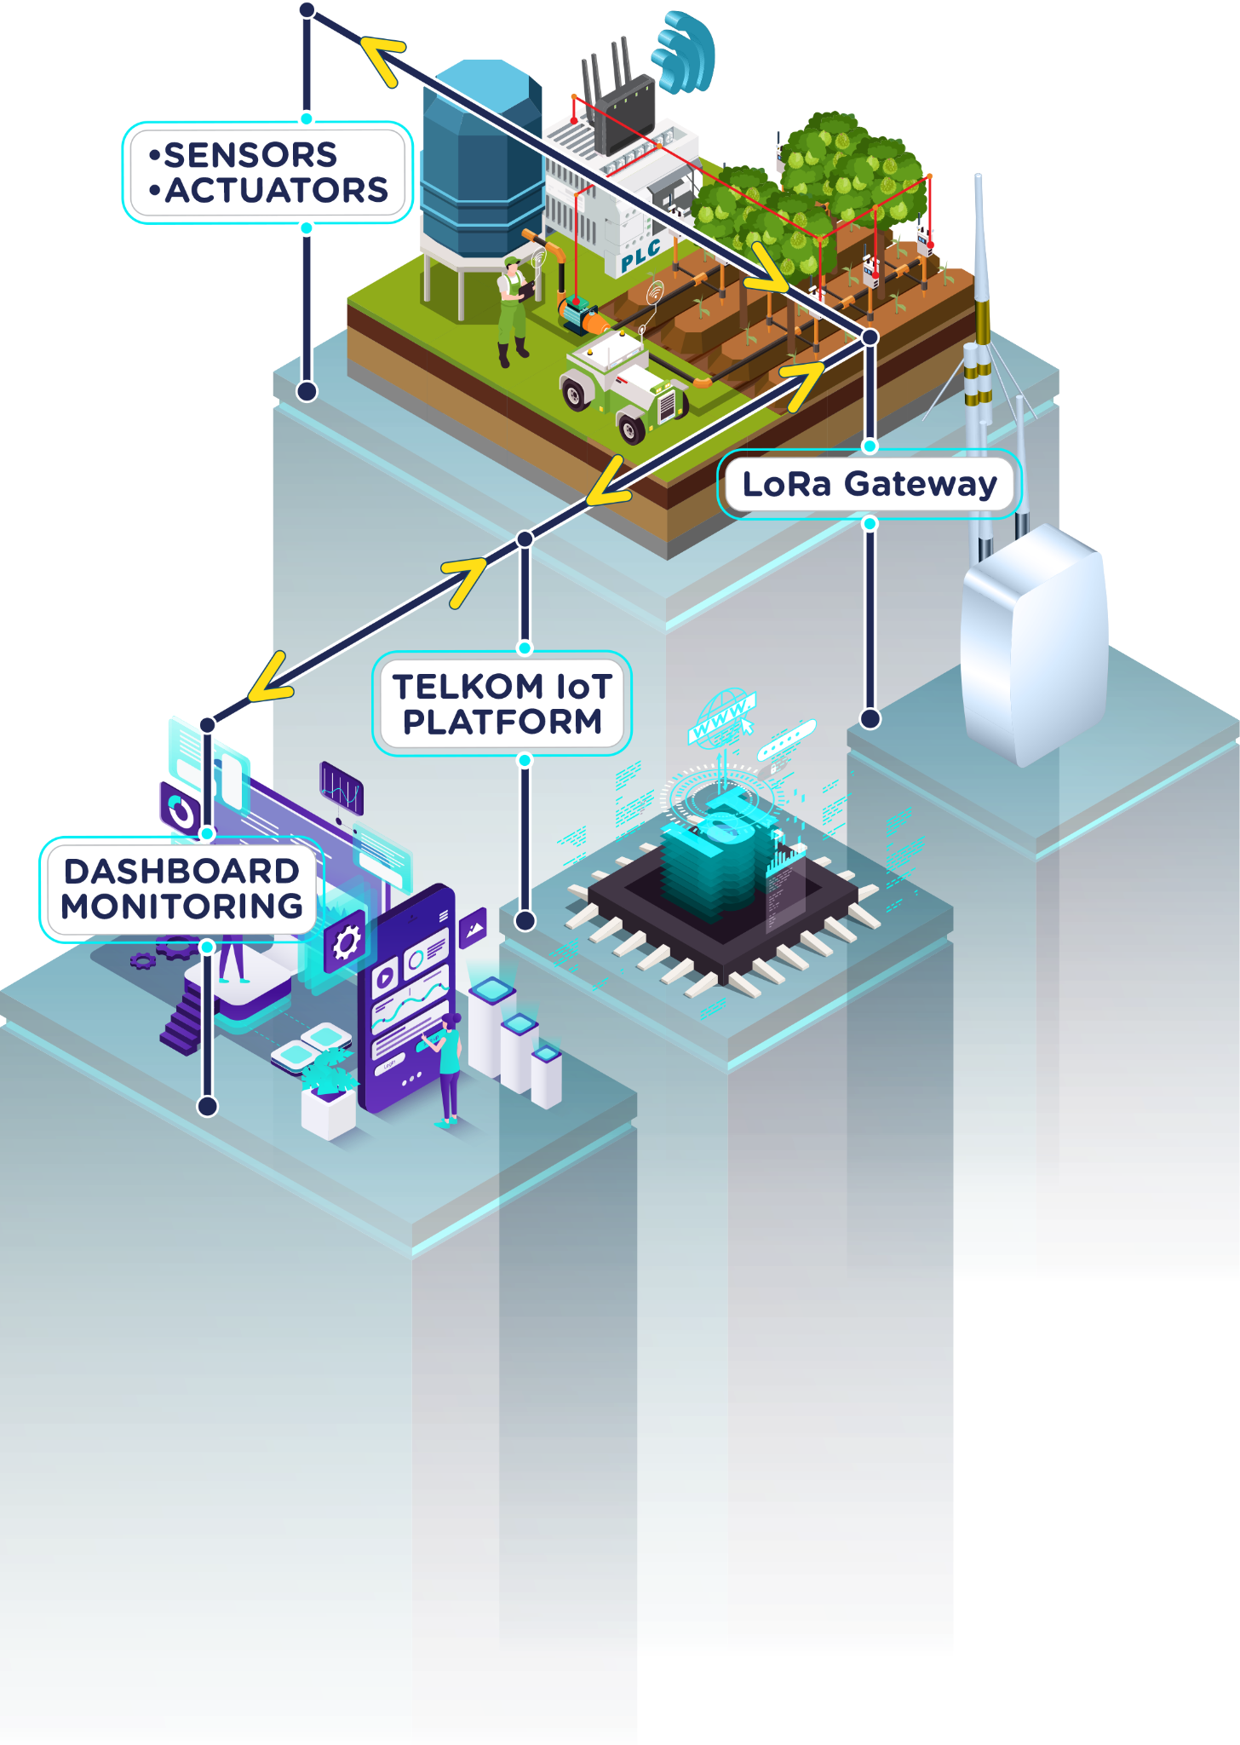
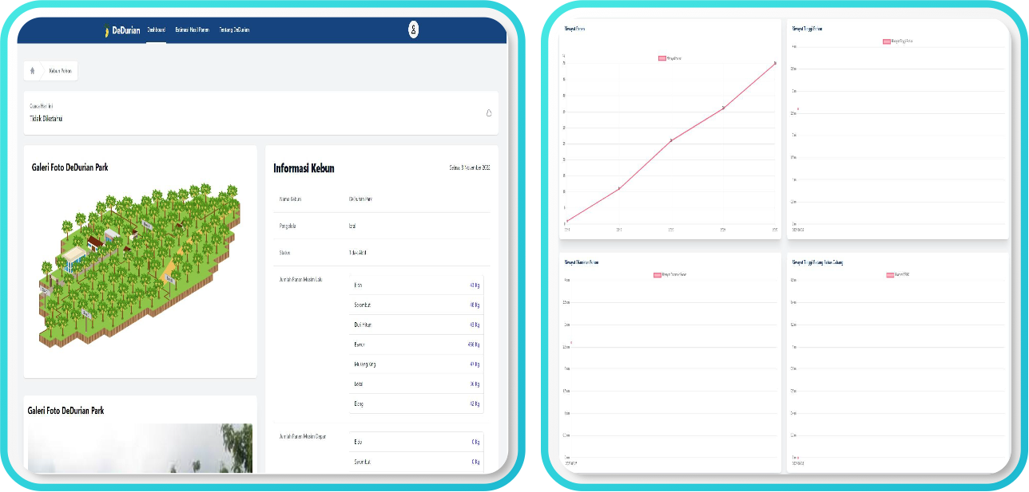
Durian Smart
Plantation
Durian Smart Plantation is a digital solution that utilizes IoT to monitor soil fertility and moisture conditions in plantations. This solution develops a Smart Watering Distribution System to treat water and fertilizer concentrates on soil conditions according to the data generated by sensors from IoT. In tree mapping and garden management, Durian Smart Plantation uses remote sensing technology through an unmanned aerial vehicle (UAV) and displays data through digital applications that are accessed via the website.

Slide 16
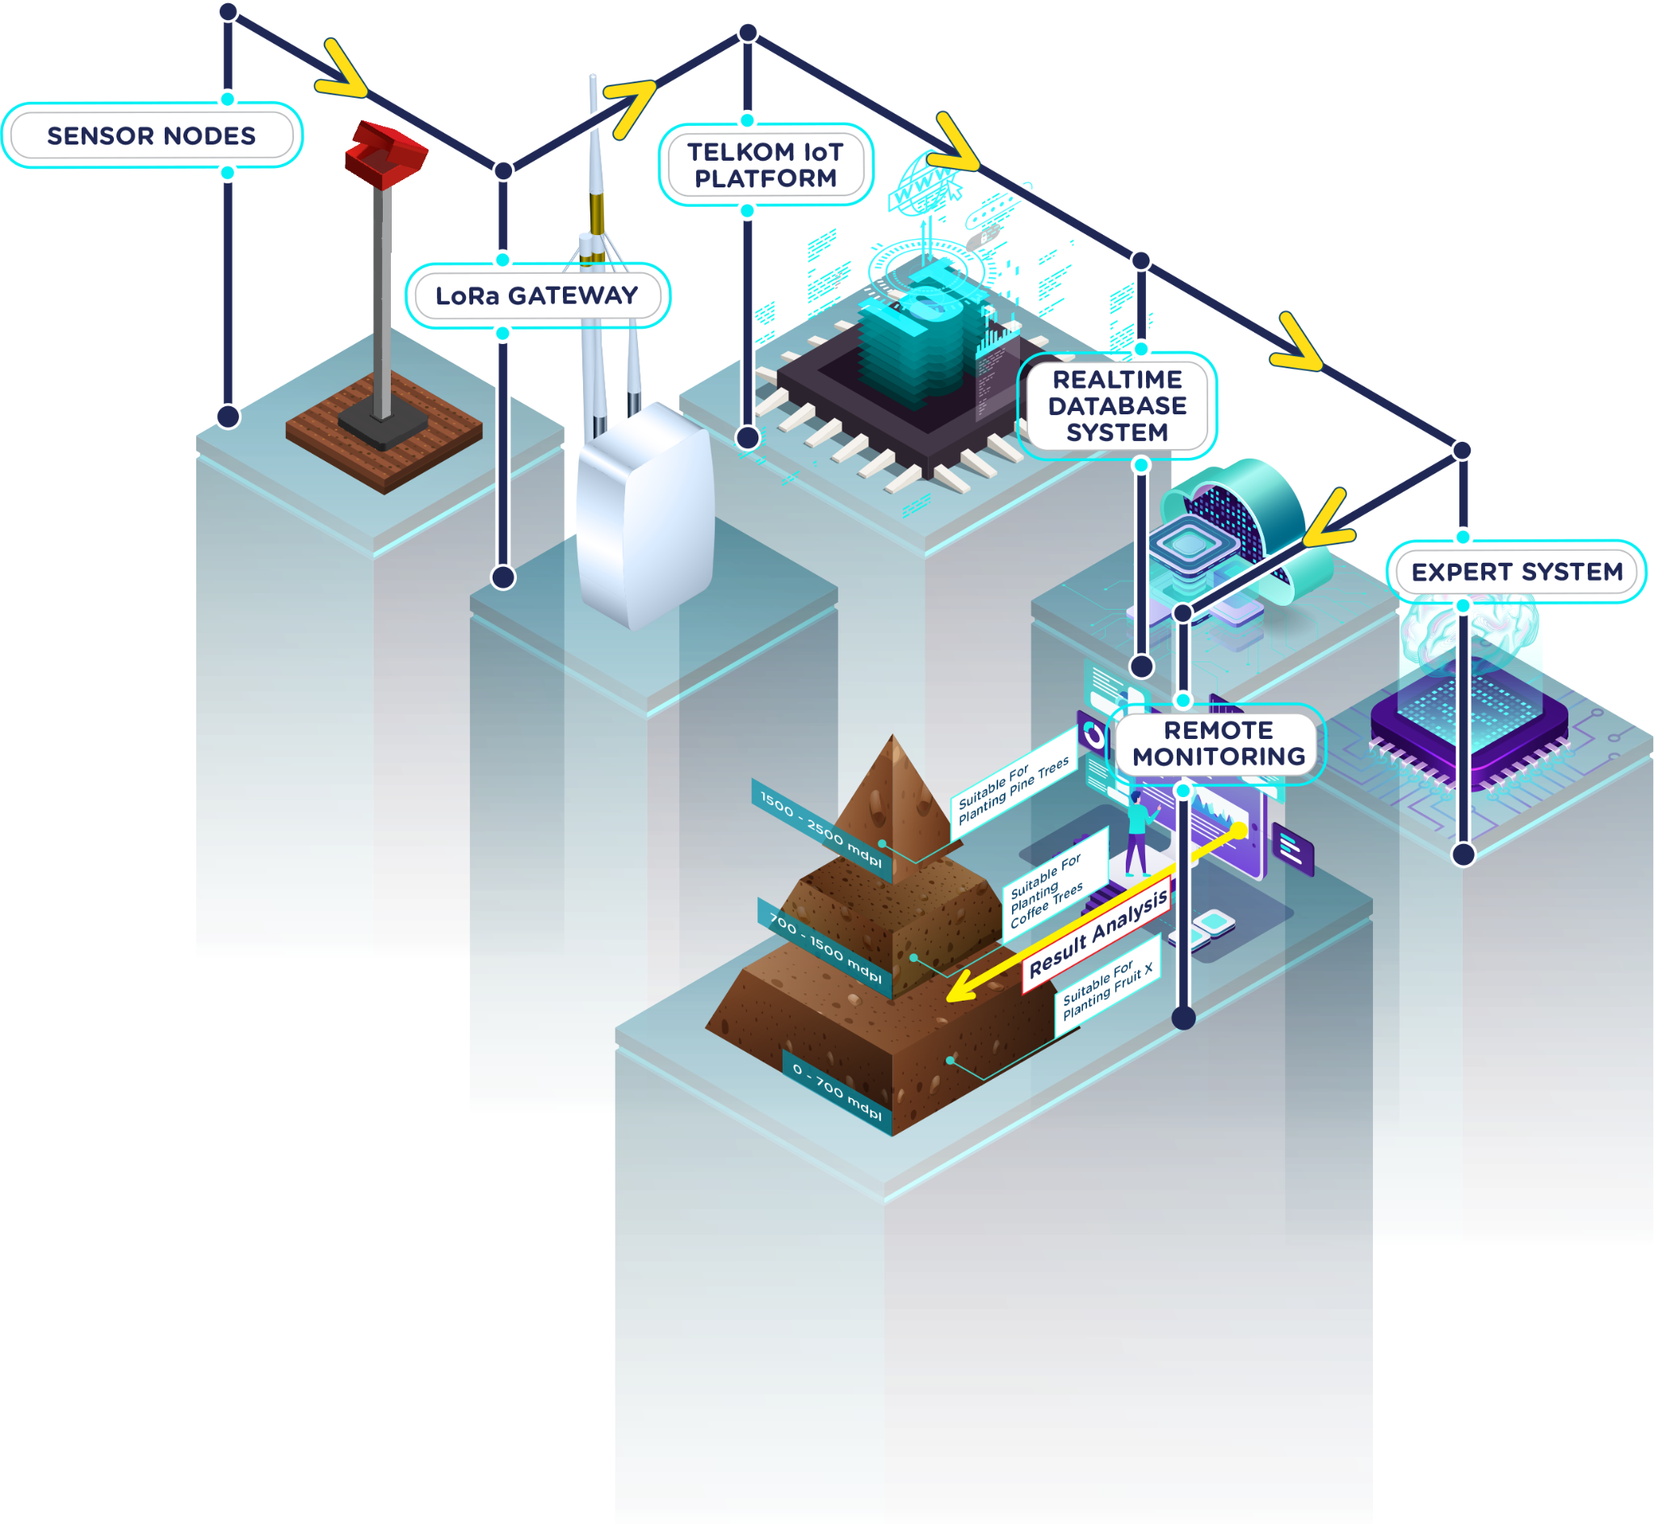
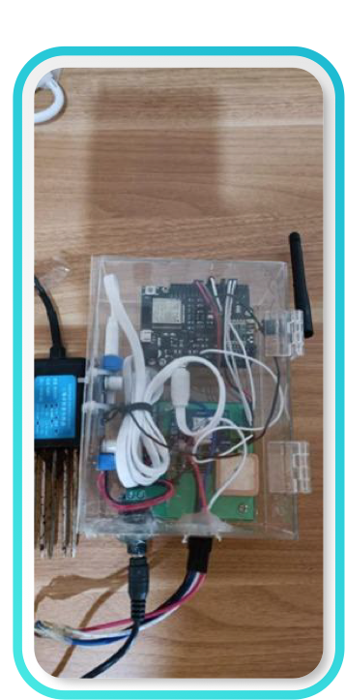
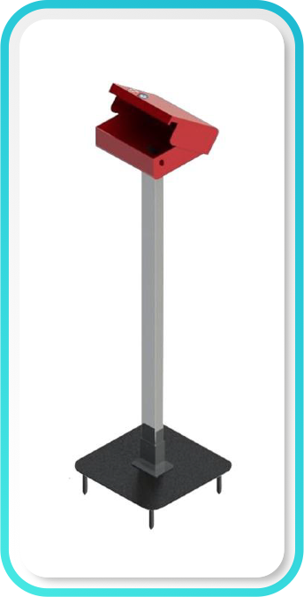
Soil Nutrients Monitoring
Soil Nutrients Monitoring is a solution for developing soil nutrient sensor devices in the designated land area to get Nitrogen, Phosphorus, Potassium, pH, Moisture and Electric Conductivity measurement content to determine what types of plants are suitable to be planted in the area. This sensor is also equipped with battery power, GPS, a waterproof design and LoRa connectivity so it can monitors soil nutrients for a long period of time (low cost and low maintenance), and can be monitored through the personal dashboard.

Slide 17



Digital Prayer Mat
The Digital Prayer Mat is used to track the cleanliness status of the prayer rug using RFID technology. For the operation of the Digital Prayer Mat, it will be assisted by Radio Frequency Identification Tag & Reader technology which has function to identify, retrieve, and store data remotely without requiring a touch. In addition, the Digital Prayer Mat also uses the Telkom Internet of Things Platform which aims to communicate, connect, and exchange data through other devices as long as it is connected to the internet. With the help of the application, the congregation of the mosque will know whether the prayer rug is still suitable for use or should be placed in a warehouse to be washed to minimize the spread of COVID-19.

Slide 18

How to Connect to Telkom IoT Platform Console in 5 Minutes

Slide 19

Thank You
Contact Us:
platform@telkomiot.id
itdri.telkomiot.id
Notes:
add logo(s)

